Slide 1
Lecture 10: Priority Queue and Binary Heap
Keren Zhu
kerenzhu@cse.cuhk.edu.hk

Slide 2
Announcement
HW3 due Feb. 20
Quiz 1 Feb. 20 in class
Midterm Feb. 26 in class
You are allowed to have a one-page double-sided cheatsheet
Regular A4 size
In the exam (not in the quiz), the pseudocode for the following algorithms will be provided

Slide 3
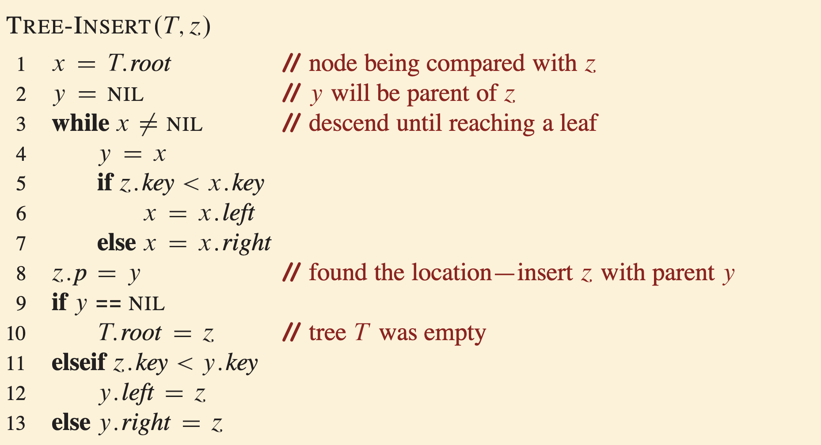
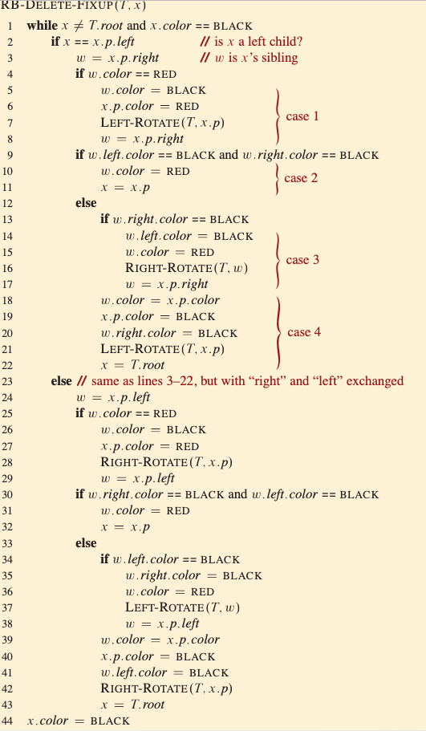
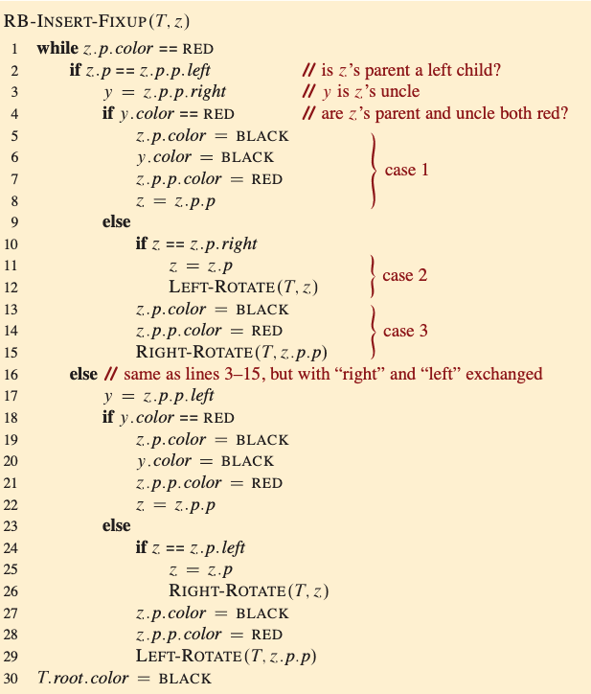
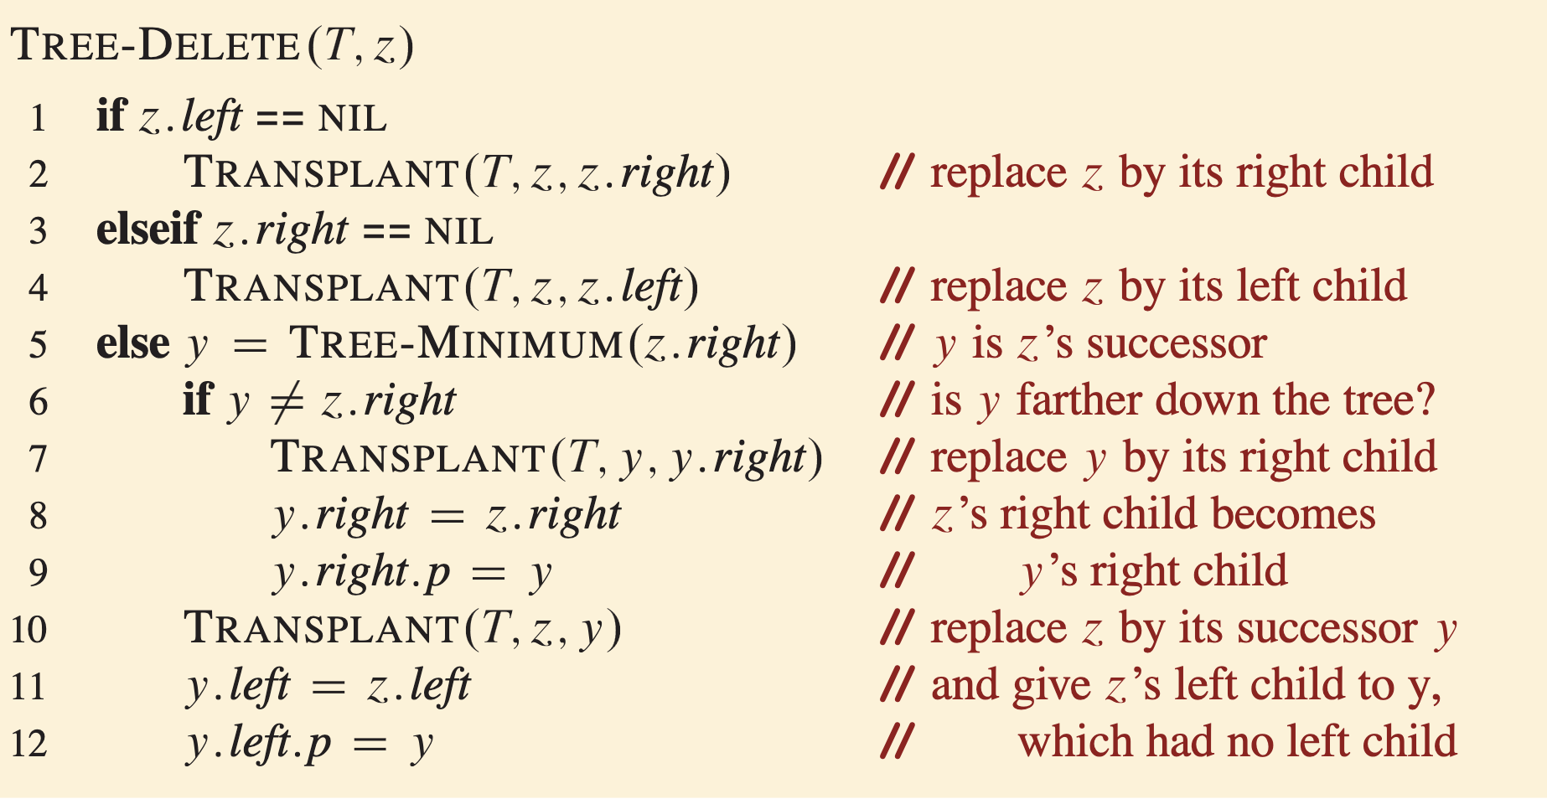

Slide 4
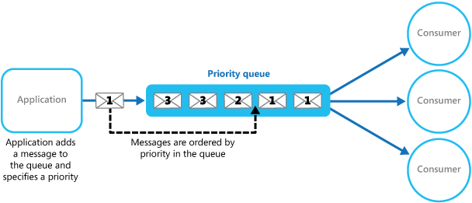
Queues with priorities
A regular queue is first in first out
The object values are treated equal
In many application, the stored object has a priority
A student decides which assignment to do first
A processor decide which process to execute next
A path-finding algorithm decides where to explore next
We want to efficiently extract a max (or min)

Slide 5
Priority queue
A priority queue stores a set of elements.
Each element has an associated priority
A priority queue can the following operations:
1. insert(e): Add a new element e to the PQ
2. Extract-Max(): Remove the element with the highest priority from the PQ and return it
A higher priority can be defined by either a lower value or a larger value
Often, we want a peek (find-max or find-min) function to look up the highest priority element without modifying the PQ

Slide 6
Implement a priority queue with a red-black tree
We could simply insert the objects into a red-black tree where the order is given by the stated priority:
Insert
Ο(log(n)), using the insert in BRT
Peek
Ο(log(n)),, using the min/max function
Extract-Max
Ο(log(n)),, using deletion function
A simpler and more efficient data structure for PQ is binary heap

Slide 7
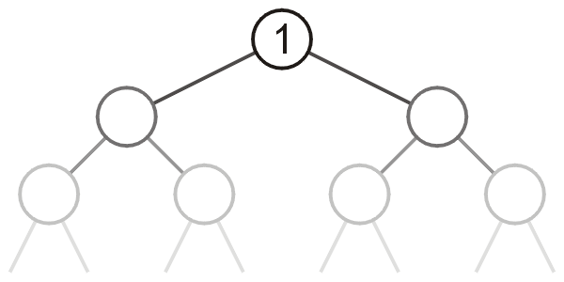
Heaps
Can we do better?
That is, can we reduce some (or all) of the operations down to Ο(1)?
Heap is a tree with the top object at the root
We will look at binary heaps
Other types exist

Slide 8
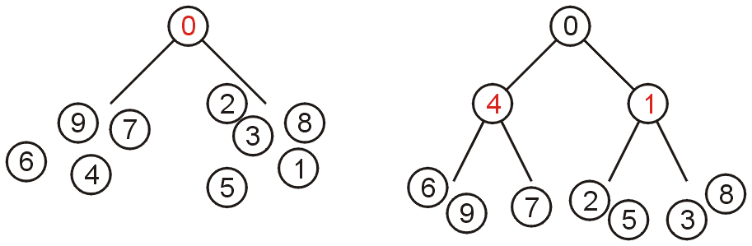
Definitions
A non-empty binary tree is a min-heap if
The tree is complete
The key associated with the root is less than or equal to the keys associated with either of the sub-trees (if any)
Both of the sub-trees (if any) are also binary min-heaps
From this definition
A single node is a heap
All keys in either sub-tree are greater than the root key

Slide 9
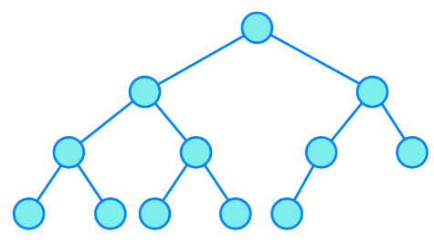
Additional notes
A complete binary tree is a binary tree in which every level, except possibly the last, is completely filled, and all nodes in the last level are as far left as possible.
There is no other relations between the elements in the two subtrees
It is easy to switch the algorithm for a min and max heap
In C++, complement the comparison function does the job

Slide 10
Examples
a heap
10
not a heap
10
20
80
5
18
40
60
85
99
3
7
50
700
So:
Where is the highest-priority item?
What is the height of a heap with n items?

Slide 11
Operations: basic idea
peek : return root.data
Extract:
answer = root.data
Move right-most node in last row to root to restore structure property
“Percolate down” to restore heap property
insert:
Put new node in next position on bottom row to restore structure property
“Percolate up” to restore heap property
The legalization procedure is often called heapfy
10
20
80
40
60
85
99
50
700
Overall strategy:
Preserve structure property
Break and restore heap property

Slide 12
Insert algorithm
We perform insert on a binary heap as follows:
1. Create a leaf node z with key e, while ensuring that T is a complete binary tree
2. Set u = z
3. If u is the root, return
4. If u has a larger key than is parent p, return
5. Otherwise, swap the u and p, then set u=p, and repeat from step 3

Slide 13
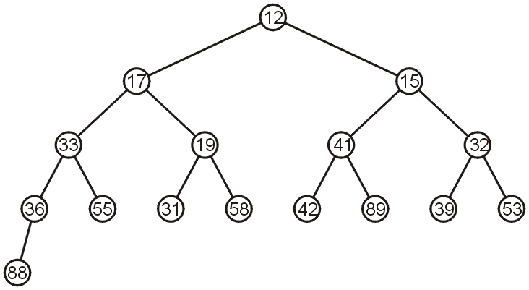
Insert
If we insert into a complete tree, we need only place the new node as a leaf node in the appropriate location and percolate up

Slide 14
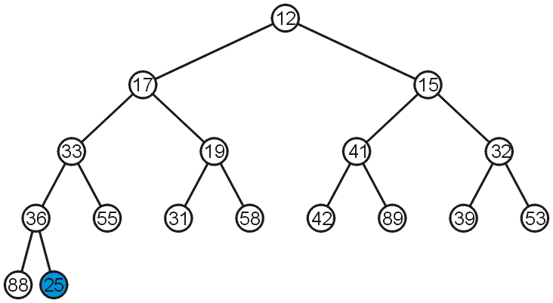
Insert
For example, push 25:

Slide 15
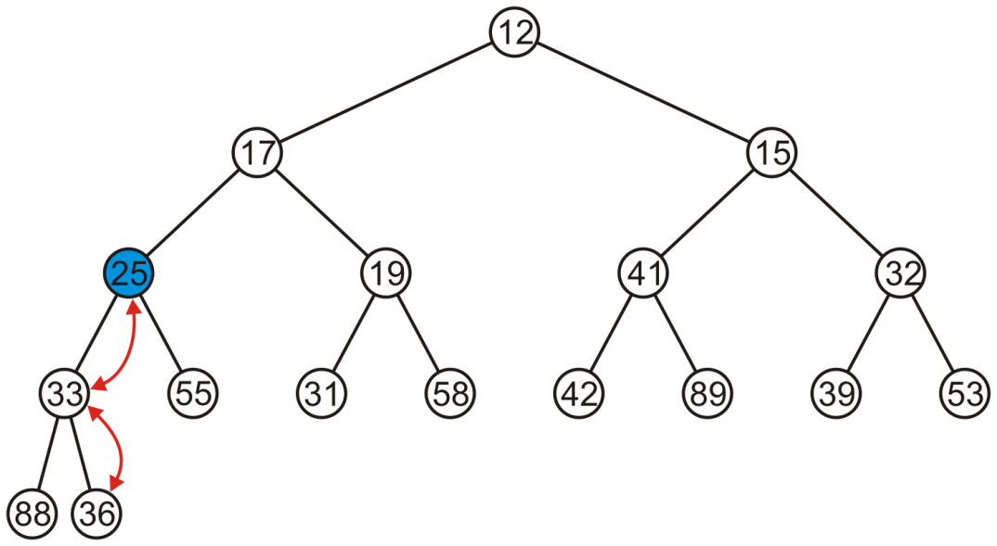
Insert
We have to percolate 25 up into its appropriate location
The resulting heap is still a complete tree

Slide 16
Extract algorithm
We perform extract on a binary heap T as follows:
1. Report the key of the root
2. Identify the rightmost leaf z at the bottom level of T
3. Delete z and store the key of z at the root
4. Set u = root
5. If u is leaf, return
6. If u has a smaller key than both children, return
7. Otherwise, let v be the child of u with a smaller key. Swap u and v. Set u = v, and repeat from Step 5

Slide 17
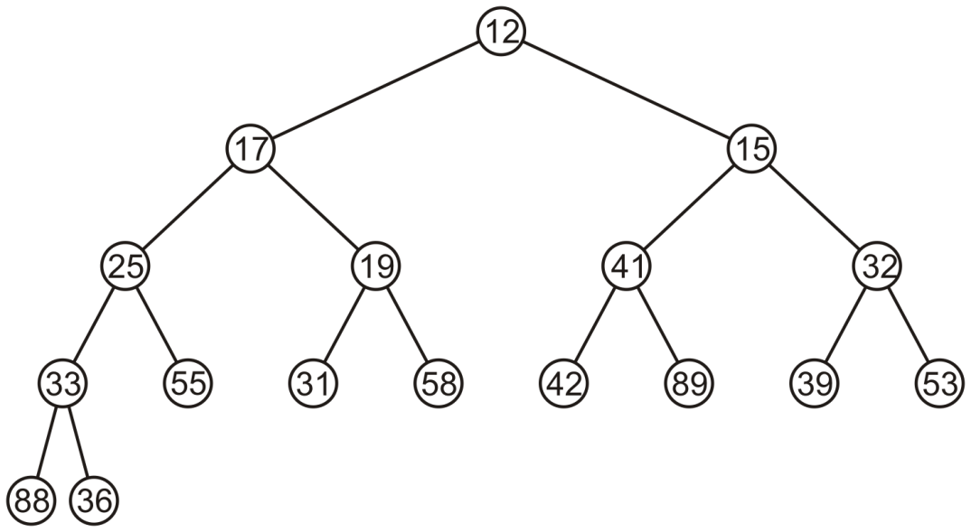
Extract
Suppose we want to pop the top entry: 12

Slide 18
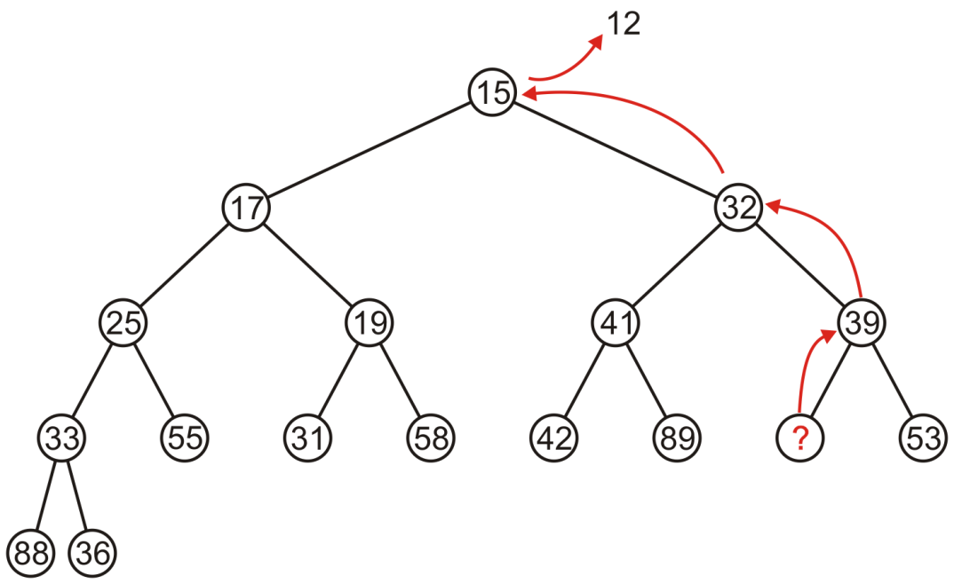
Extract
Percolating up creates a hole leading to a non-complete tree

Slide 19
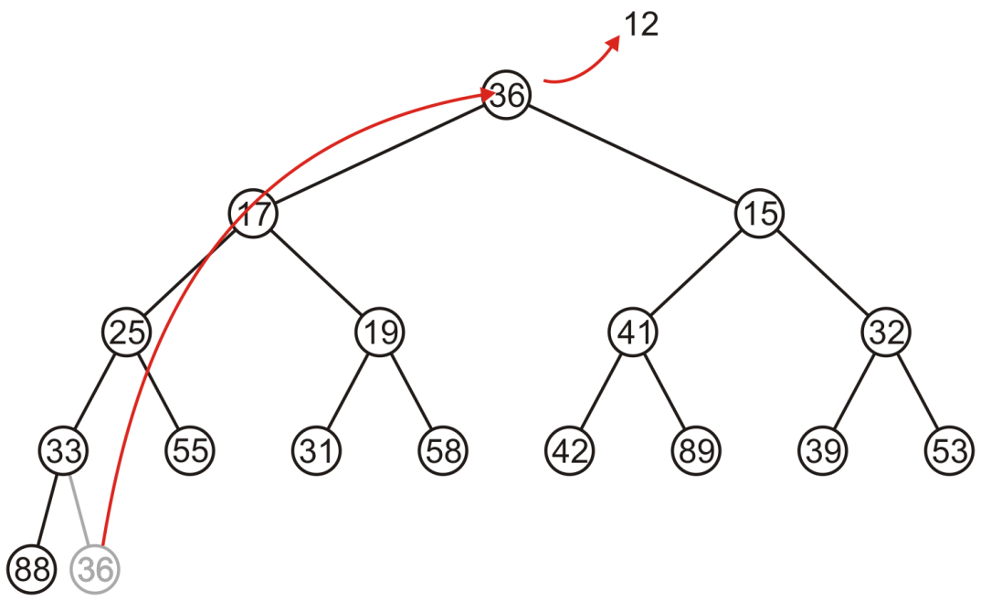
Extract
Alternatively, copy the last entry in the heap to the root

Slide 20
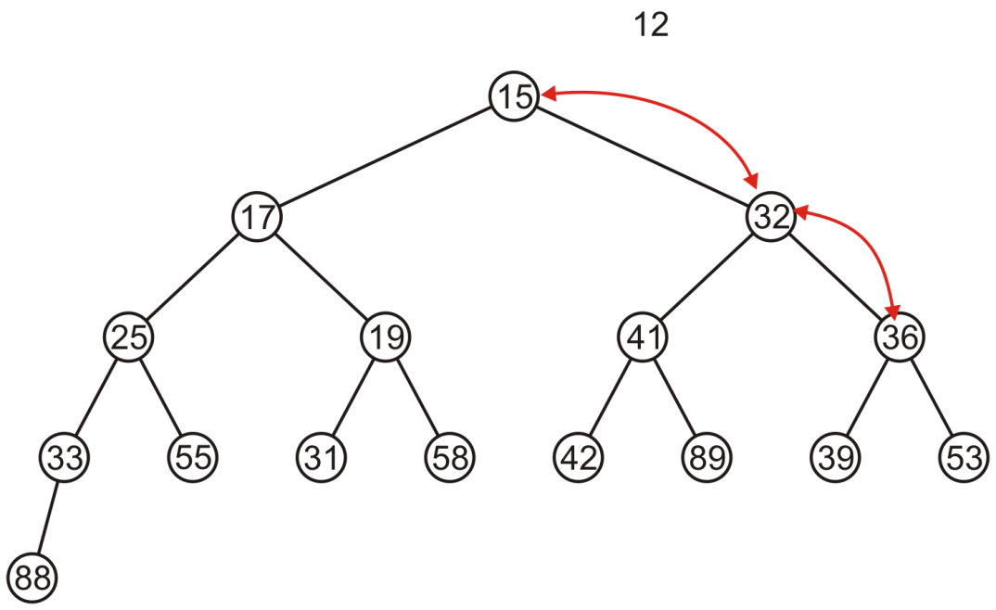
Extract
Now, percolate 36 down swapping it with the smallest of its children
We halt when both children are larger

Slide 21
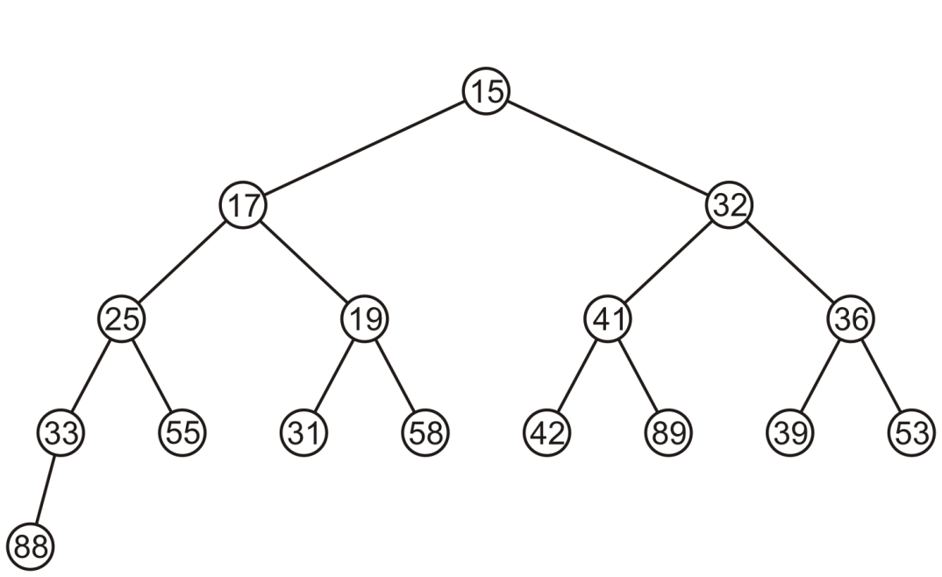
Extract
The resulting tree is now still a complete tree:

Slide 22
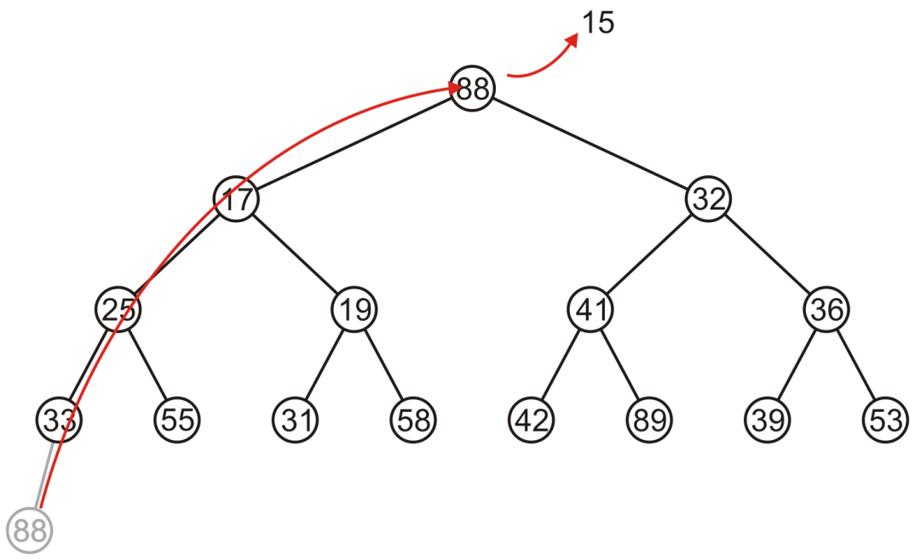
Extract
Again, popping 15, copy up the last entry: 88

Slide 23
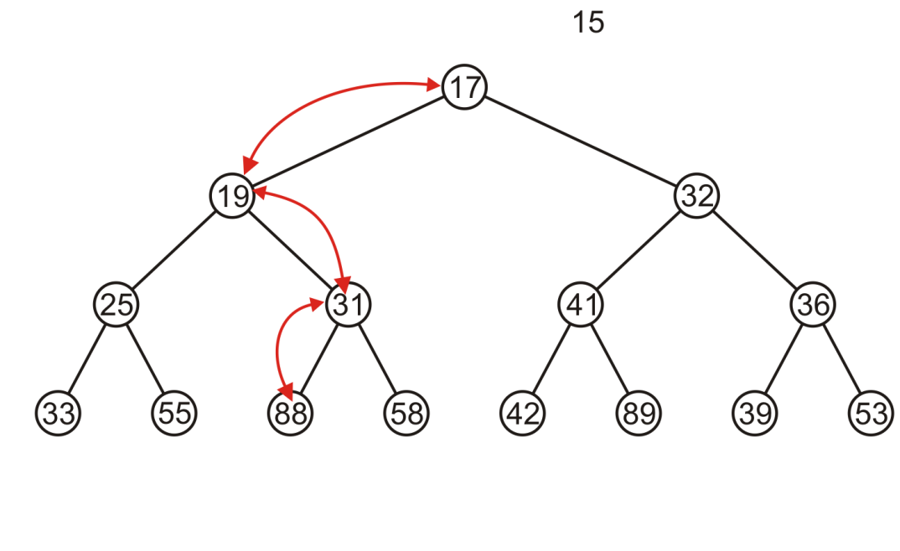
Extract
This time, it gets percolated down to the point where it has no children

Slide 24
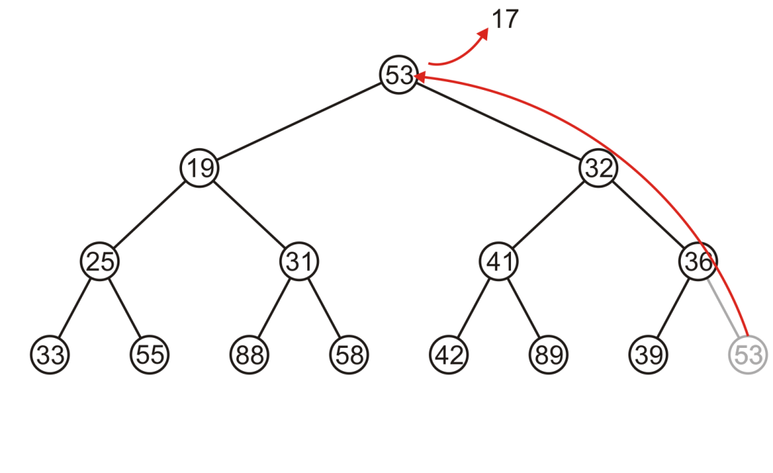
Extract
In popping 17, 53 is moved to the top

Slide 25
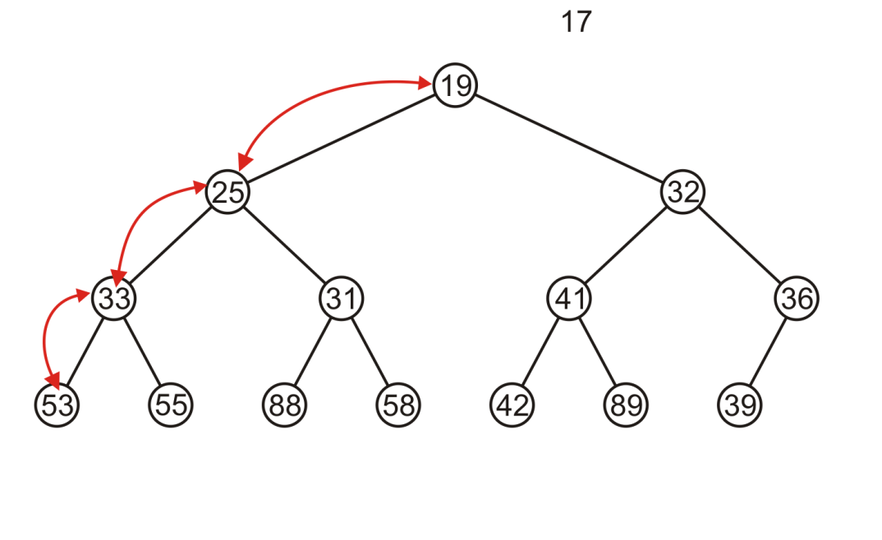
Extract
And percolated down, again to the deepest level

Slide 26
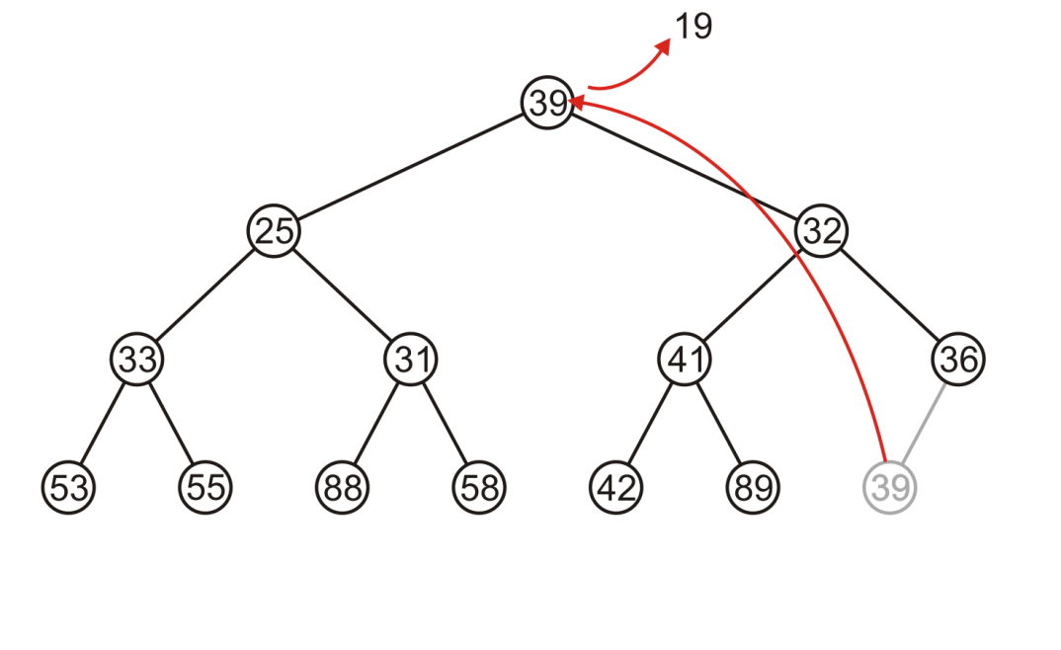
Extract
Popping 19 copies up 39

Slide 27
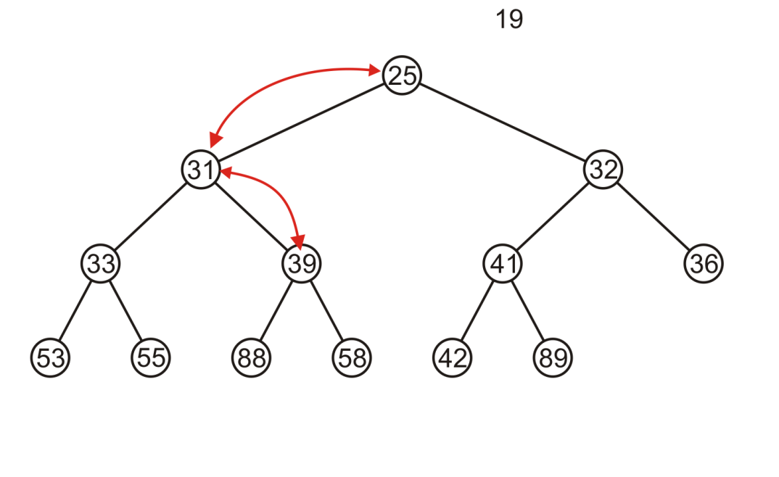
Extract
Which is then percolated down to the second deepest level

Slide 28
The runtime analysis
The “percolate-up” and “percolate-down” both goes to the height of the tree in the worst case
However, how to find the rightmost leaf node?
The naïve approach is to do a tree traversial, but then it is O(n)
The complete tree structure allows us to do a trick

Slide 29

Array Implementation
For the heap
a breadth-first traversal yields:

Slide 30
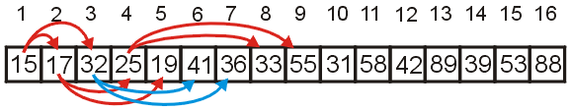
Array Implementation
Recall that If we associate an index–starting at 1–with each entry in the breadth-first traversal, we get:
Given the entry at index k, it follows that:
The parent of node is a k/2 parent = k >> 1;
the children are at 2k and 2k + 1 left_child = k << 1; right_child = left_child | 1;
Cost (trivial): start array at position 1 instead of position 0

Slide 31
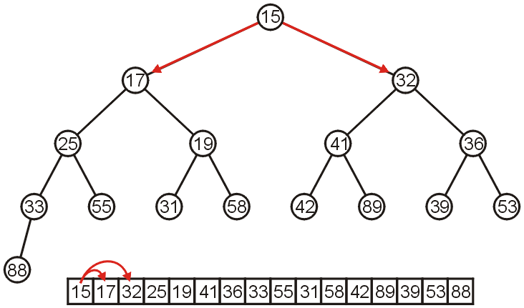
Array Implementation
The children of 15 are 17 and 32:

Slide 32
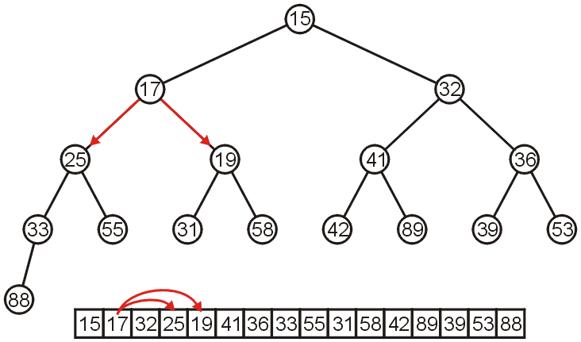
Array Implementation
The children of 17 are 25 and 19:

Slide 33
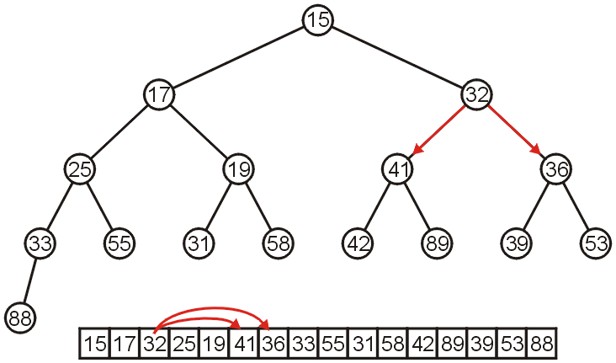
Array Implementation
The children of 32 are 41 and 36:

Slide 34
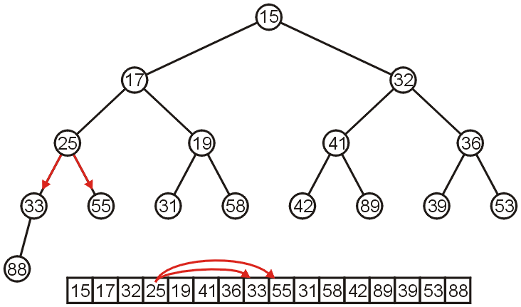
Array Implementation
The children of 25 are 33 and 55:

Slide 35
Array Implementation
If the heap-as-array has count entries, then the next empty node in the corresponding complete tree is at location posn = count + 1
We compare the item at location posn with the item at posn/2
If they are out of order
Swap them, set posn /= 2 and repeat

Slide 36
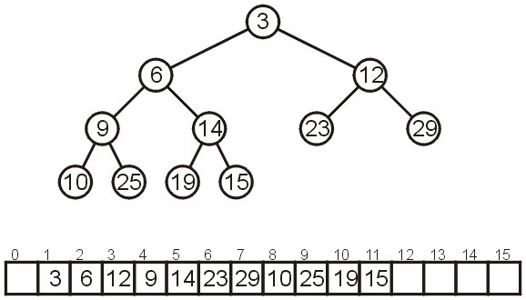
Array Implementation
Consider the following heap, both as a tree and in its array representation
Where is the rightmost element?
The last element in the array

Slide 37
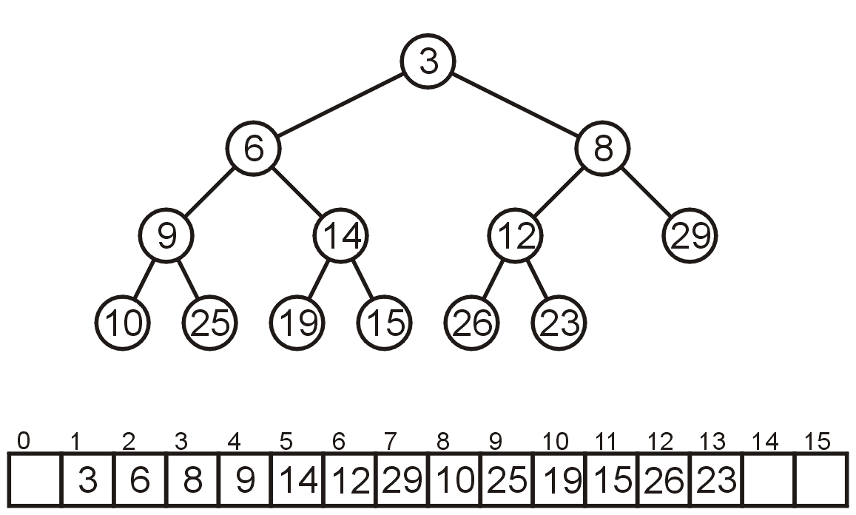
Array Implementation: extract example
As before, extract the top has us copy the last entry to the top

Slide 38
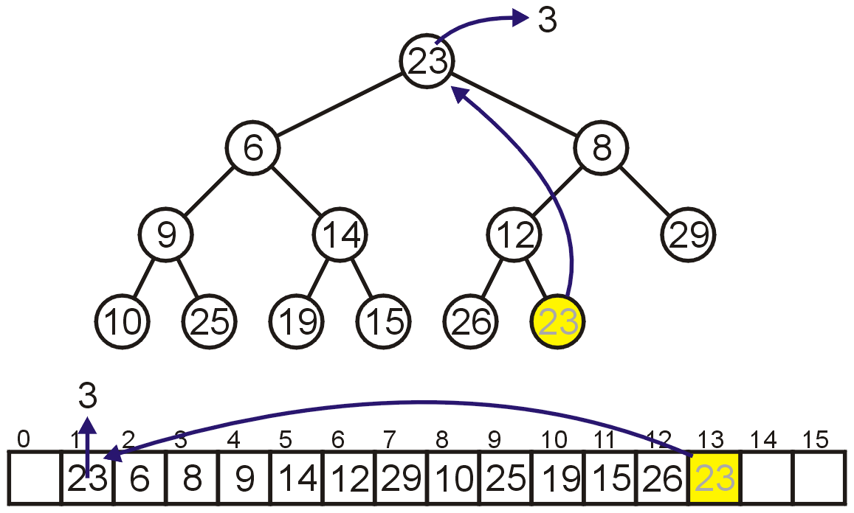
Array Implementation: extract example
Instead, consider this strategy:
Copy the last object, 23, to the root

Slide 39
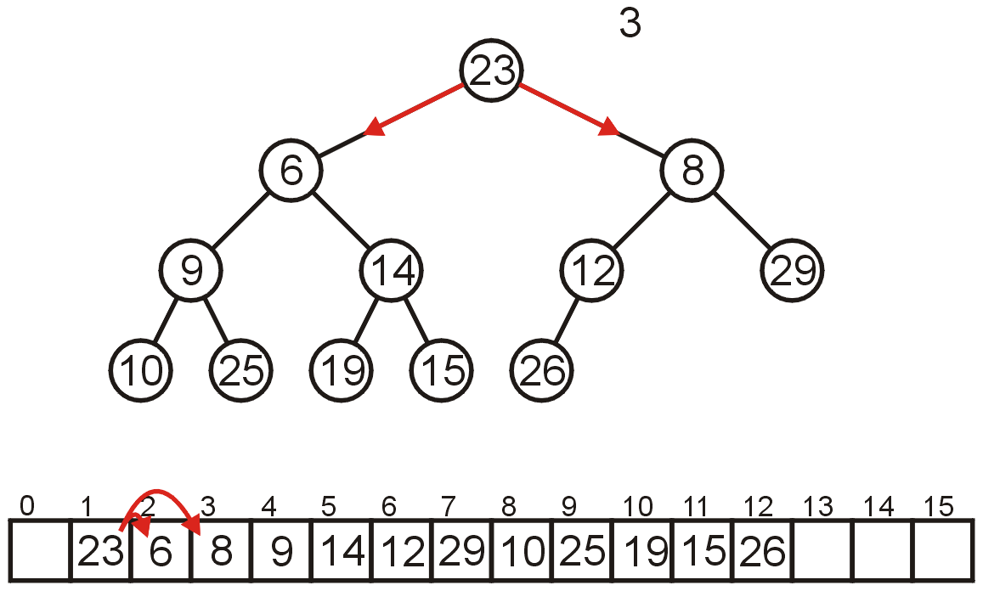
Array Implementation: extract example
Now percolate down
Compare Node 1 with its children: Nodes 2 and 3
Swap 23 and 6

Slide 40
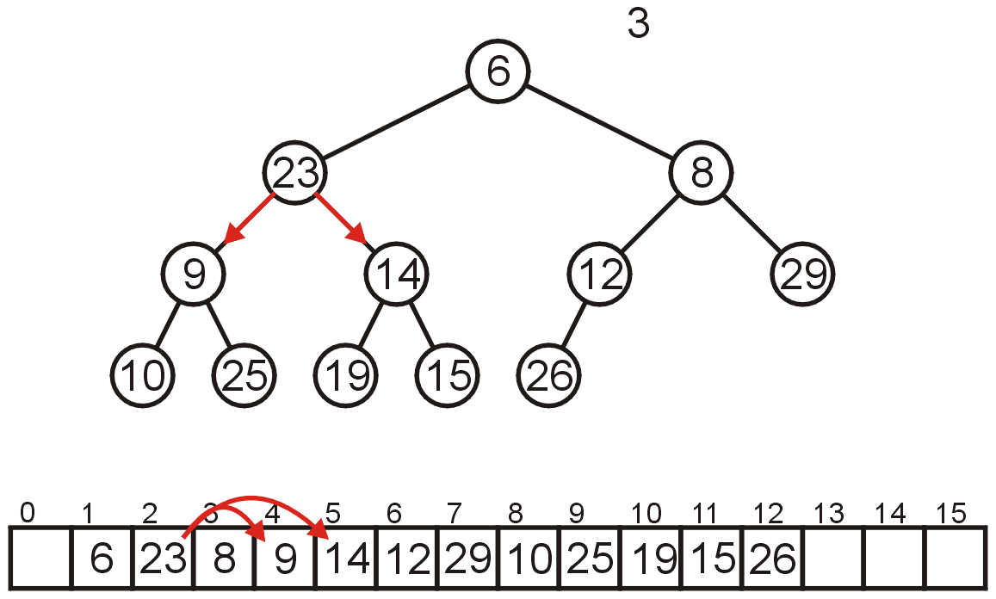
Array Implementation: extract example
Compare Node 2 with its children: Nodes 4 and 5
Swap 23 and 9

Slide 41
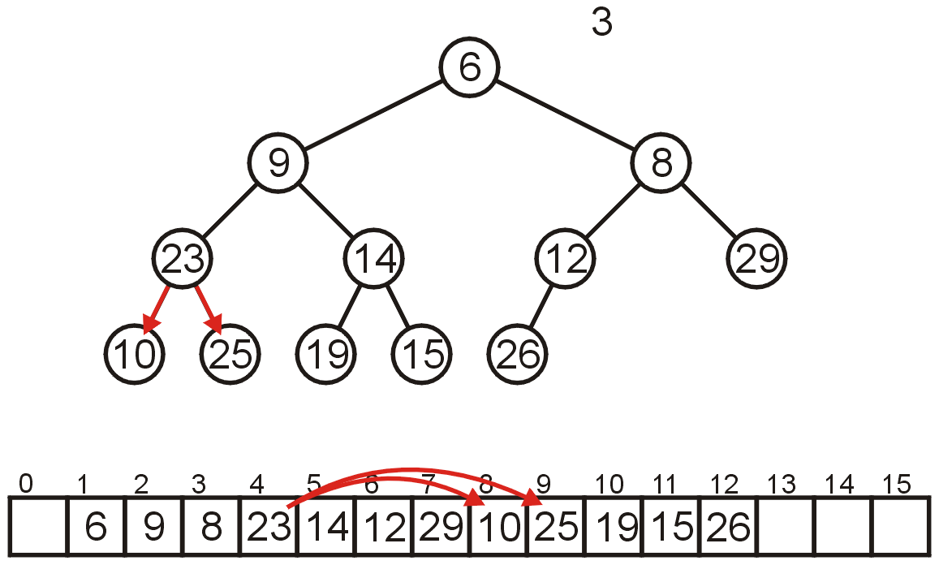
Array Implementation: extract example
Compare Node 4 with its children: Nodes 8 and 9
Swap 23 and 10

Slide 42
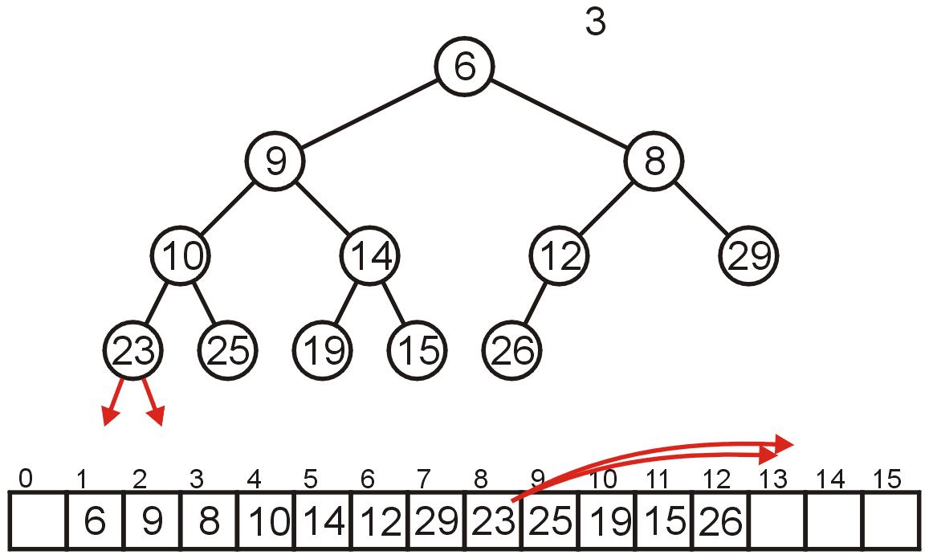
Array Implementation: extract example
The children of Node 8 are beyond the end of the array:
Stop

Slide 43
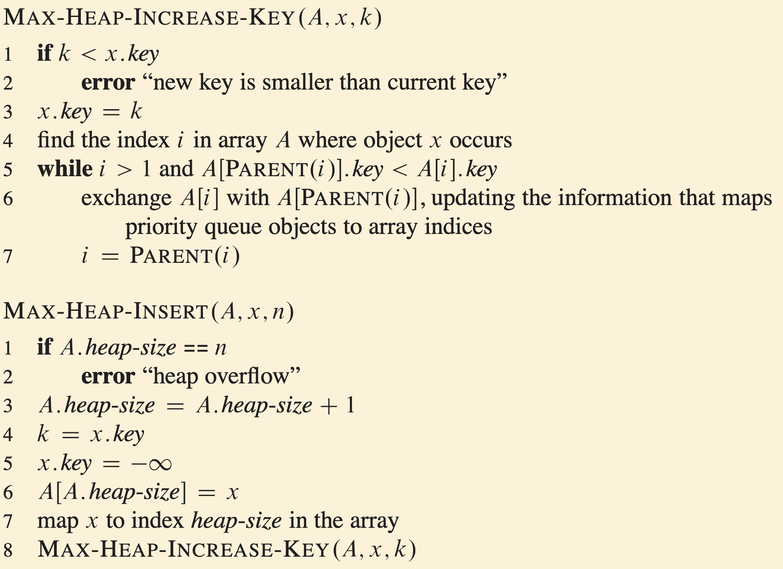
Pseudocode for insertion
Procedure to insert an element in a max heap

Slide 44
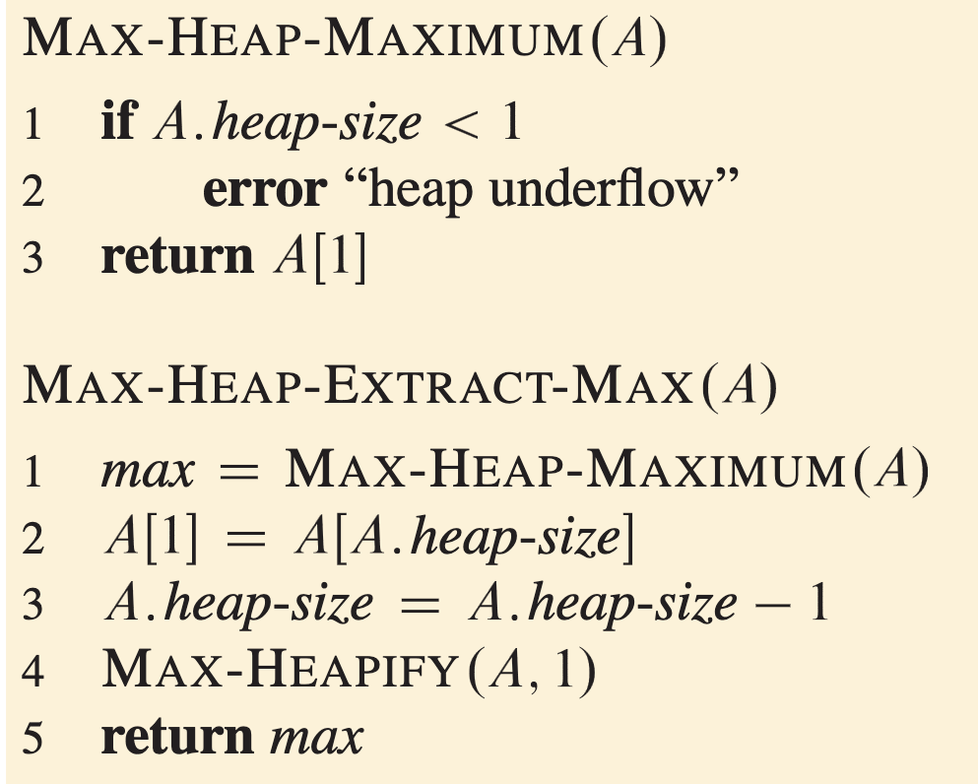
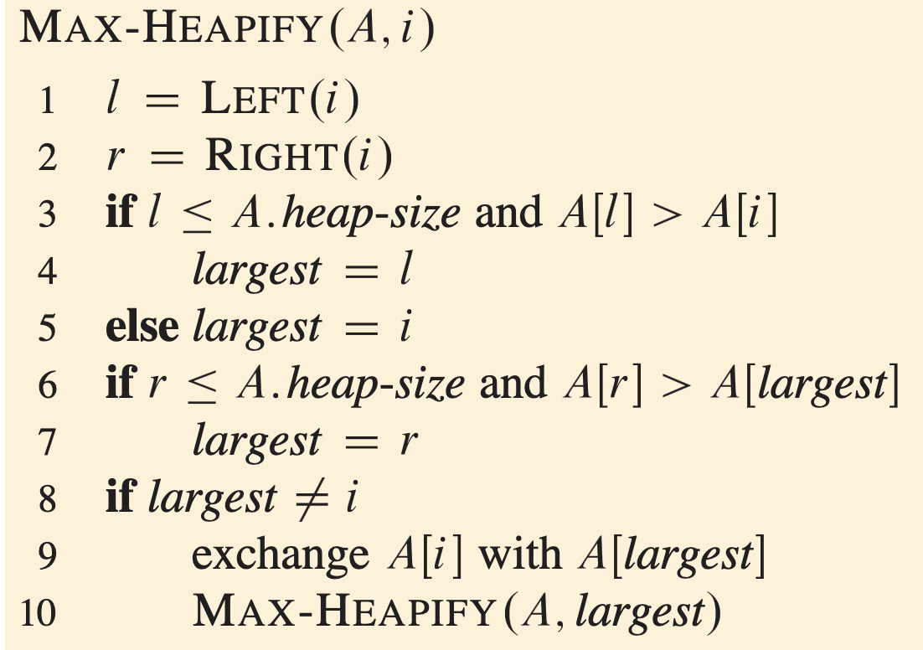
Pseudocode for extraction
Procedure to extract an element in a max heap

Slide 45
Worst-case runtime analysis for binary heap
Peek
O(1)
Insert
O(log n)
Extract/delete
O(log n)
Find
We did not define a function to do it
Unlike binary search tree, we don’t have relation property between subtrees
Need to do linear search O(n)

Slide 46
Summary
Priority queue is an abstract data type allows us to efficiently looking up for the element with “highest priority”
Binary heap is a popular data structure for priority queue (and other applications)
It uses an array to represent a complete binary tree
There are many types of heap
n-ary heap
Fibonacci heap: gives Θ(1) amortized time for insertion
Heap is a useful data structure for a lot of algorithms
For example, Prim’s algorithm for minimum spanning tree, which select a cheapest edge in a graph every iteration

